Slide 1
Welcome to
Total Quality Management
(19MEE347)
Unit 3 – Quality Function Deployment
Name: Dr. Sunil Kumar
Department of Mechanical Engineering

Slide 2
Introduction - QFD
Quality Function Deployment (QFD) is an approach to design introduced in Japan in 1966 by Yoji Akao.
Dr. Akao is a professor of industrial Engineering at Tamagawa University in Tokyo and is one of the foremost leaders in the TQC movement in Japan. He has long led and participated in many of the key research committees of the Union of Japanese Scientists and Engineers (JUSE), the Japanese Standards Association (JSA) and the Japanese Society for Quality Control (JSQC)

Slide 3
Why QFD ???
A lack of well defined product development processes in research and design can be the root cause for the ruination of a company.
To have a successful product, we must understand user needs.
QFD provides a formal process to understand user needs and to weave these needs across the entire product development cycle including manufacturing.

Slide 4
QFD - Definition
QFD is a very systematic and organized approach of taking customer needs and demands in the consideration when designing a new products and services or when improving existing products and services.

Slide 5
Customer Driven Product Development
Phase I: Product Planning
Phase II: Part Deployment
Phase III: Process Planning
Phase IV: Production planning
Design
Requirements
Cu
Sto
mer
vo
ice
Parts
Requirements
D
e
s
i
g
n
Phase I: Product Planning
Process
Requirements
Production
Standards
P
a
r
t
s
Phase II: Part Deployment
P
r
o
c
e
s
s
Phase IV: Production planning
Phase III: Process Planning

Slide 6
QFD - Benefits
Customer Driven
Reduces Implementation Time
Promotes Teamwork
Provides Documentation

Slide 7
QFD - Benefits
CUSTOMER DRIVEN
Creates forces on customer requirements
Uses competitive information effectively
Prioritizes resources
Identifies items that can be acted upon
Structures resident experience / Information

Slide 8
QFD - Benefits
REDUCES IMPLEMENTATION TIME
Decreases midstream design charge
Limits post introduction problems
Avoids future development redundancies
Identifies future application opportunities
Surfaces missing assumptions

Slide 9
QFD - Benefits
PROMOTES TEAMWORK
Consensus based
Creates communication at interfaces
Identifies actions at interfaces
Creates global view out of details

Slide 10
QFD - Benefits
PROVIDES DOCUMENTATION
Documents rationale for design
Is easy to assimilate
Adds structure to the information
Adapts to changes, a living document
Provides framework for sensitivity analysis

Slide 11
Voice of the Customer
Driving Force Behind QFD
  Customer Dictates Attributes Of Product
Customer Satisfaction
  Meeting Or Exceeding Customer Expectations
  Customer Expectations Can Be Vague & General In Nature
  Customer Expectations Must Be Taken Literally, Not Translated Into What The Organization Desires

Slide 12
Collecting Customer Information
What Does Customer Really Want ?
What Are Customer’s Expectations ?
Are Customer’s Expectations Used To Drive Design Process ?
What Can Design Team Do To Achieve Customer Satisfaction?

Slide 13
Types Of Customer Information
Solicited, Measurable, Routine
  Cus. & Market Surveys, Trade Trials
Unsolicited, Measurable, Routine
  Customer Complaints, Lawsuits
Solicited, Subjective, Routine
  Focus Groups
Solicited, Subjective, Haphazard
  Trade & Cus. Visits, Indep. Consultants
Unsolicited, Subjective, Haphazard
  Conventions, Vendors, Suppliers

Slide 14
House of Quality
Interrelationship
between
Technical Descriptors
Technical Descriptors
(Voice of the organization)
Customer Requirements
(Voice of the Customer)
Relationship between
Requirements and Descriptors
Prioritized Customer
Requirements
Prioritized Technical
Descriptors

Slide 15
Building a House of Quality
List Customer Requirements (What’s)
List Technical Descriptors (How’s)
Develop Relationship (What’s & How’s)
Develop Interrelationship (How’s)
Competitive Assessments
Prioritize Customer Requirements
Prioritize Technical Descriptors

Slide 16
QFD Matrix
Relationship between
Customer Requirements and
Technical Descriptors
WHATs vs. HOWs
Technical Descriptors
Primary
Interrelationship between
Technical Descriptors
(correlation matrix)
HOWs vs. HOWs
Secondary
+9
Strong
Secondary
+3
Medium
Primary
+1
Weak
+9
Strong Positive
+3
Positive
-3
Negative
-9
Strong Negative
Prioritized Customer
Requirements
Customer Requirements
Technical
Competitive
Assessment
Our
A’s
B’s
Our
A’s
B’s
Customer Importance
Target Value
Scale-up Factor
Sales Point
Absolute Weight
Degree of Technical Difficulty
Target Value
Absolute Weight and Percent
Customer
Competitive
Assessment
Relative Weight and Percent
Prioritized Technical Descriptors

Slide 17
Customer Requirements (What’s)
Secondary
Tertiary
Primary
Customer Requirements
(WHATs)

Slide 18
Technical Descriptors (How’s)
Secondary
Tertiary
Primary
Technical Descriptors
(HOWs)

Slide 19
L - Shaped Diagram
Technical Descriptors
Primary
Secondary
Secondary
Primary
Customer Requirements

Slide 20
Relationship Matrix
Technical Descriptors
Primary
Secondary
Secondary
Primary
Relationship between
Customer Requirements and
Technical Descriptors
WHATs vs. HOWs
Customer
Requirements
+9
Strong
+3
Medium
+1
Weak

Slide 21
Correlation Matrix
Interrelationship between Technical
Descriptors (correlation matrix)
HOWs vs. HOWs
Technical Descriptors
+9
Strong Positive
Primary
+3
Positive
-3
Negative
Secondary
-9
Strong Negative
Secondary
Primary
Relationship between
Customer Requirements and
Technical Descriptors
WHATs vs. HOWs
Customer Requirements
+9
Strong
+3
Medium
+1
Weak

Slide 22
Customer Competitive Assessment
5
3
1
2
5
1
4
4
Relationship between
Customer Requirements and
Technical Descriptors
WHATs vs. HOWs
Customer Requirements
+9
Strong
+3
Medium
+1
Weak
Ours
A’s
B’s
Customer
Competitive
Assessment

Slide 23
Technical Competitive Assessment
5
3
1
2
5
1
4
4
Relationship between
Customer Requirements and
Technical Descriptors
WHATs vs. HOWs
Customer Requirements
+9
Strong
Our
A’s
B’s
1 3 4 2
1 2 1 4
+3
Medium
Technical
Competitive
Assessment
+1
Weak
Our
A’s
B’s
Customer
Competitive
Assessment

Slide 24
Prioritized Customer Requirements
Importance Rating
Target Value
Scale-Up Factor
Sales Point
Absolute Weight & Percent
  (Importance Rating)
  (Scale-Up Factor)
  (Sales Point)

Slide 25
Technical Descriptors
Primary
Relationship between
Customer Requirements and
Technical Descriptors
WHATs vs. HOWs
Secondary
Secondary
Primary
+9
Strong
5
3
1
2
5
1
4
4
7
3
9
10
2
4
8
1
5
3
2
3
5
2
4
4
+3
Medium
1.2
1.5
1
1
1.5
1
1.5
1
+1
Weak
Prioritized Customer
Requirements
Customer Requirements
1.5
1
15
3
Technical
Competitive
Assessment
Our
A’s
B’s
1 3 4 2
1 2 1 4
Our
A’s
B’s
Customer Importance
Target Value
Scale-up Factor
Sales Point
Absolute Weight
Customer
Competitive
Assessment

Slide 26
Relationship between
Customer Requirements and
Technical Descriptors
WHATs vs. HOWs
Technical Descriptors
Primary
Interrelationship between
Technical Descriptors
(correlation matrix)
HOWs vs. HOWs
Secondary
+9
Strong
Secondary
+3
Medium
Primary
+1
Weak
+9
Strong Positive
+3
Positive
5
3
1
2
5
1
4
4
7
3
9
10
2
4
8
1
5
3
2
3
5
2
4
4
1.2
1.5
1
1
1.5
1
1.5
1
-3
Negative
-9
Strong Negative
Prioritized Customer
Requirements
Customer Requirements
1.5
1
15
3
Technical
Competitive
Assessment
Our
A’s
B’s
1 3 4 2
1 2 1 4
Our
A’s
B’s
Customer Importance
Target Value
Scale-up Factor
Sales Point
Absolute Weight
Degree of Technical Difficulty
1 8 4 2
9 8 2 5
Target Value
2 3 4 3
1 3 1 5
Absolute Weight and Percent
90
Customer
Competitive
Assessment
Relative Weight and Percent
133
Prioritized Technical Descriptors

Slide 27
QFD Summary
Orderly Way Of Obtaining Information & Presenting It
Shorter Product Development Cycle
Considerably Reduced Start-Up Costs
Fewer Engineering Changes
Reduced Chance Of Oversights During Design Process
Environment Of Teamwork
Consensus Decisions
Preserves Everything In Writing

Slide 28
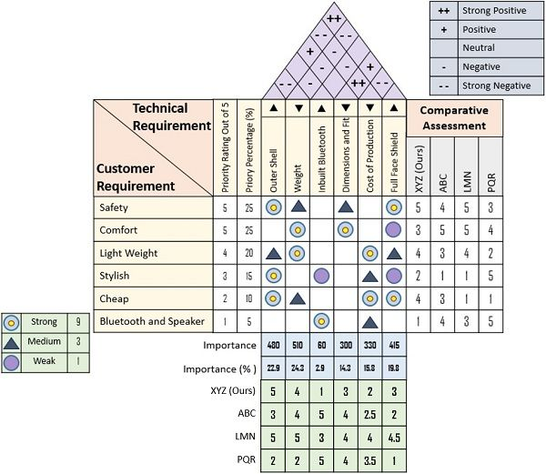
QFD Example
Notes:
https://theinvestorsbook.com/quality-function-deployment-qfd.html

Slide 30
THANK YOU!!!

